Slide 1
PYTHON 3 BASICS

Slide 2
Python - Syntax
Indentation:
Use 4 spaces for indentation or use a tab.
Consistent indentation defines code blocks.
Comments:
Single-line: #
Multi-line: ''' or """
Variables:
Start with a letter or _.
Case-sensitive.
Data Types:
int, float, str, list, tuple, dict, set, bool.
Strings:
Enclose in ', ", ''', or """.
Use \ for escape characters.
Operators:
Arithmetic: +, -, *, /, //, %, **
Comparison: ==, !=, <, >, <=, >=
Logical: and, or, not
Assignment: =, +=, -=, *=, /=
Bitwise: &, |, ^, ~, <<, >>
Functions:
Define with def name():
Use return to return a value.

Slide 3
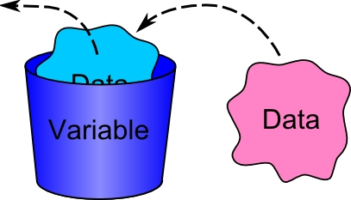
Variables
A variable is a named storage location in a program that holds a value that can be changed during the execution of the program.
Name = “Hello”

Slide 4
Data Types
Numeric Types:
int: Integer numbers (e.g., 5, -3)
float: Floating-point numbers (e.g., 3.14, -2.0)
complex: Complex numbers (e.g., 1+2j)
Sequence Types:
str: Strings (e.g., "hello", 'world')
list: Ordered, mutable collections (e.g., [1, 2, 3])
tuple: Ordered, immutable collections (e.g., (1, 2, 3))
Mapping Type:
dict: Key-value pairs (e.g., {'key': 'value'})
Set Types:
set: Unordered collections of unique elements (e.g., {1, 2, 3})
Boolean Type:
bool: Boolean values (True, False)

Slide 5
Casting
Casting is the process of converting one data type to another. In Python, you can cast between different data types using built-in functions.
Implicit Casting: Done automatically by Python to prevent data loss and ensure correct operations.
Explicit Casting: Done manually by the programmer to ensure correct data types.
Common Casting Functions:
int(): Converts a value to an integer.
float(): Converts a value to a float.
str(): Converts a value to a string.
complex(): Converts a value to a complex number.
bool(): Converts a value to a boolean.

Slide 6
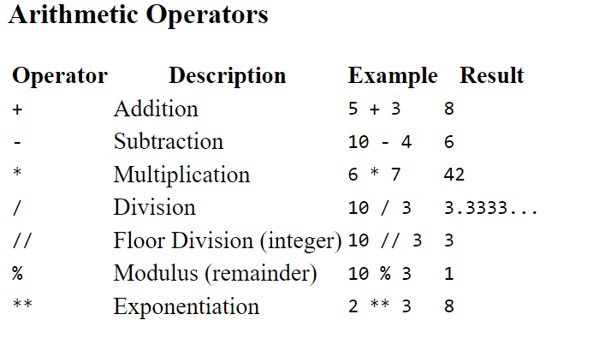
Operators

Slide 7
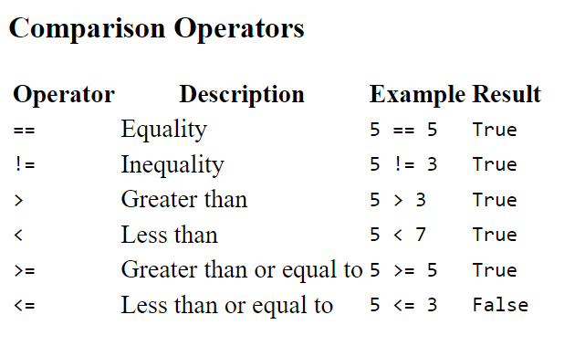
Operators

Slide 8
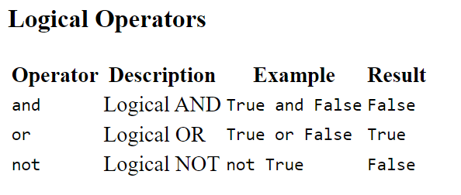
Operators

Slide 9
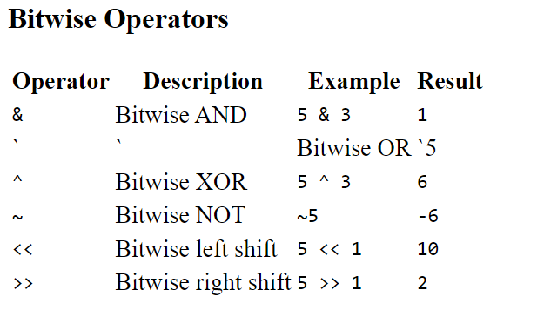
Operators

Slide 10
User-Input
User Input in programming refers to the process of receiving data from the user of a program. It allows the program to interact with the user and respond based on the data provided.
Asking for the user's name and age
name = input("Enter your name: ")
age = input("Enter your age: ")
Displaying the collected information
print(“Your name: ”,name)
print(“Your age: ”,age)

Slide 11
Exercises
WAP to create a Basic Calculator using the if,elif concept.
WAP Converts temperatures between Celsius to Fahrenheit & Vice-Versa
Formula: C = (F - 32) × 5/9, Where F will be input.
Formula: F = (9/5)C + 32, Where C will be input.
WAP to Calculate Simple Interest.
Formula: I = P x T x R / 100
WAP to Check if the user is eligible for Voting or Not.
The user has to be more than 18 years old, else print “Not eligible”.
WAP to find the Square & Cube of the given number.

